Slide 1

EE675: COURSE PROJECT – final evaluation cost-aware cascading bandits instructor : prof. Subrahmanya Swamy peruru Link to code - View Python Code
Presented by:
Rajvardhan verma (210819)
Rohit raj (210874)
Saurabh Vishwakarma (210949)
Notes:
Hello everyone, my name is rajv.... and i welcome you all to the end term presentation of our EE675 course project.
The topic which we are dealing with is Cost-aware cascading bandits. as we know from our previous discussions, that it is a complex variant of multi-armed bandit problem where the aim is to optimize not just the reward but also the cost associated with each action.
This adds further complexity in its implementation and analysis, which we will see today.

Slide 2
Overview
In the Mid-Term presentation, we have discussed two algorithms – CascadeBAI(ε, δ, K) and CC-UCB(ϵ, ɑ).
The CascadeBAI algorithm gives the best arm with high probability of 1 – δ, thus it follows a fixed-confidence setting, where it tries to minimize the number of time steps with fixed risk δ.
On the other hand, in CC-UCB, we found that the algorithm is based on fixed bound of regret, that is, fixed-budget setting, and tries to minimize the number of time steps within the regret parameter ɑ.
In the upcoming slides, we will discuss the implementation of our algorithm in Python and then we will move to the analysis of time complexity bounds.
Notes:
In our Mid-Term presentation, we introduced two key algorithms that form the foundation of our project – CascadeBAI(ε, δ, K) and CC-UCB(ϵ, ɑ). Let us start by revisiting these algorithms briefly. CascadeBAI operates within a fixed-confidence setting, aiming to provide the best arm with a high probability of 1 – δ. Essentially, it focuses on minimizing the number of time steps while maintaining a fixed risk δ.
On the other hand, CC-UCB takes a different approach. It operates within a fixed-budget setting, where it aims to minimize the number of time steps within the regret parameter ɑ. This algorithm is founded on the concept of fixed bounds of regret, offering a different perspective on optimizing bandit algorithms.
In the upcoming slides, we'll walk you through our implementation of the CC-UCB algorithm in Python. Following that, we'll transition into a detailed analysis of the time complexity bounds associated with our implementation.

Slide 3
Implementation of cc-ucb algorithm
For the CC-UCB algorithm setting, we assume that the expected value of X_{i,t} (i.e., θ_{i}) and cost Y_{i,t} are unknown beforehand, and the specific value of X_{i,t} and cost Y_{i,t} is revealed to the learner once it is pulled.
This algorithm is based on the theorem provided in the research paper, which states that ranking the arms in a descending order of θ_{i}/c_{i} and only including those with θ_{i}/c_{i} > 1 in I* achieves a balanced trade-off between maximizing the expected net reward from the current arm (i.e., θ_{i} − c_{i}) and maximizing the cumulative net reward from the remaining arms in I* if the current arm has state 0.
Notes:
Now, let's talk about the implementation details of the CC-UCB algorithm. We will analyse the case of a general setting where we assume that the expected value of Xi,t (denoted as θi) and the associated cost Yi,t are unknown prior to exploration. The true values of Xi,t and Yi,t are only revealed to the learner once an arm is pulled.
Our implementation of CC-UCB algorithm is grounded in a fundamental theorem provided in the research paper. This theorem highlights the importance of ranking the arms based on the ratio of their expected value to their cost, denoted as θi/ci. We adopt a strategy of sorting the arms in descending order of θi/ci. Notably, we only include arms in our active set (denoted as I*) if their θi/ci ratio is greater than 1.
Why this approach? Well, this strategy enables us to achieve a balanced trade-off. On one hand, it allows us to maximize the expected net reward from the current arm, which is represented by θi − ci. On the other hand, it facilitates the maximization of the cumulative net reward from the remaining arms in I* if the current arm has a state of 0.
This balanced trade-off is crucial for the effectiveness of the CC-UCB algorithm, enabling us to navigate the exploration-exploitation trade-off efficiently while considering both the immediate and long-term rewards.

Slide 4

Implementation of cc-ucb algorithm
To rank θi/ci and compare it with threshold 1 for exploitation, we use a UCB-type indexing policy, which gives true estimate of θi/ci for all the arms in I*.
The algorithm aims to minimize cumulative regret, which represents the difference between the rewards obtained and the maximum possible rewards that could have been obtained.
From this algorithm, we get the values of N_{i,t} $,\hat{\text{θ}}$, $\hat{c}$ and I*, which will be used to carry out the theoretical analysis of the time complexity for the CC-UCB algorithm.
Notes:
To rank the arms based on the θi/ci ratio and compare it with a threshold of 1 for exploitation, we employ a UCB-type indexing policy. This policy ensures that we obtain a true estimate of the θi/ci ratio for all arms in our active set, denoted as I*.
The primary objective of the CC-UCB algorithm is to minimize cumulative regret. Regret, in this context, represents the difference between the rewards obtained and the maximum possible rewards that could have been obtained if the learner had perfect knowledge of the arm values from the beginning.
Throughout the execution of the algorithm, we track several key values, including Ni,t (the number of times arm i has been pulled), θ_hat (the estimated expected value of arm i), c_hat (the estimated cost of arm i), and I* (the active set of arms). These values are crucial for making informed decisions and navigating the exploration-exploitation trade-off effectively.
These values obtained from the algorithm serve as the foundation for carrying out the theoretical analysis of the time complexity for the CC-UCB algorithm.

Slide 5

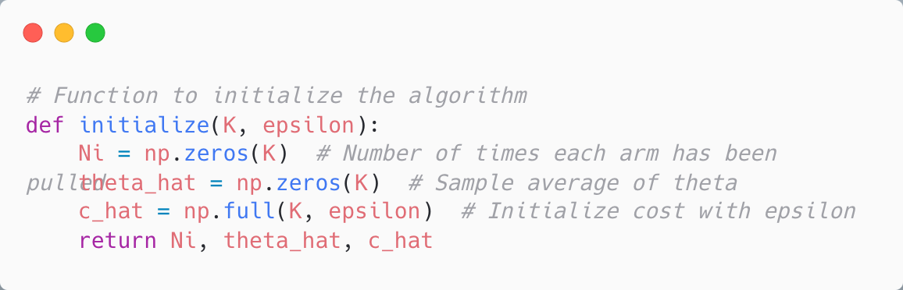
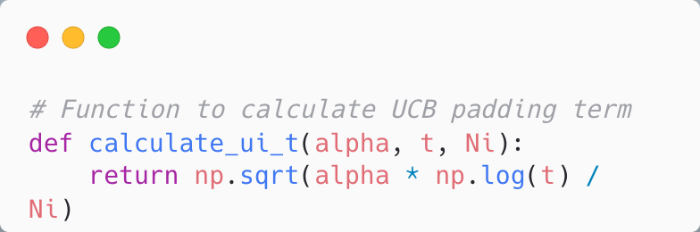
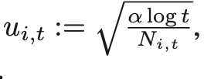
Explanation of python code
We define a function to initialize the required parameters with null values.
We have defined the confidence radius u_{i,t} as given in the research paper.
Notes:
Now, let's walk through the Python code that forms the backbone of our CC-UCB algorithm implementation. Firstly, we've defined a function to initialize the required parameters with null values. Cost can't be 0 so we have set it to epsillon. Next, we've implemented the calculation of the confidence radius, denoted as ui,t, as specified in the research paper. This confidence radius plays a pivotal role in the algorithm's decision-making process. It represents the uncertainty or confidence interval around the estimated value of the arm, guiding the exploration-exploitation trade-off.

Slide 6
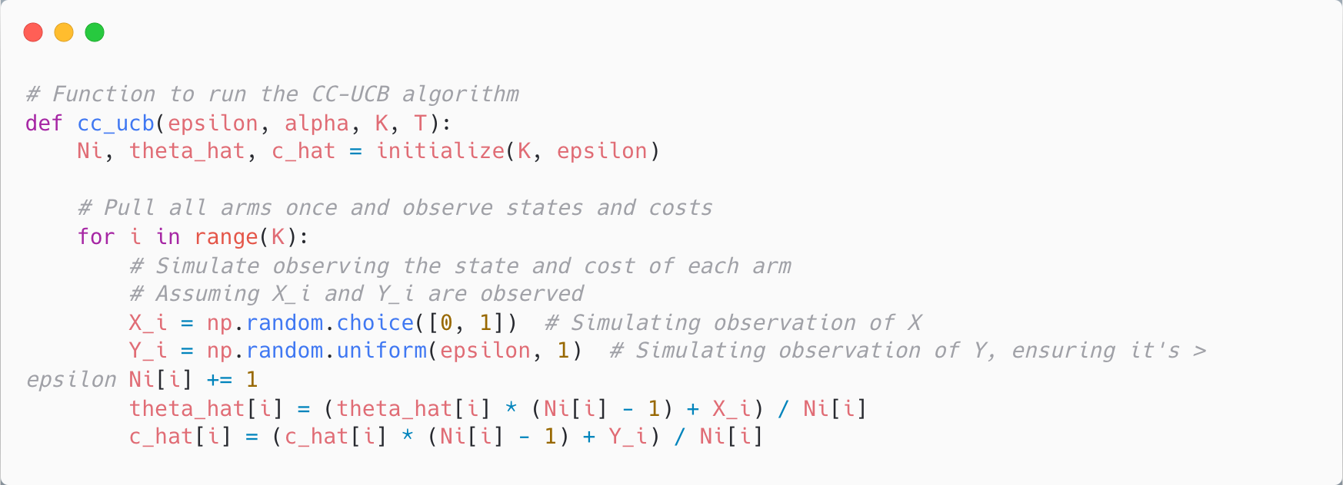
Explanation of python code
The CC-UCB function takes four parameter – epsilon (ϵ), alpha (ɑ), number of arms (K) and total time steps (T).
For the first run, we pull all the arms one-by-one, to observe the values of state and cost.
Notes:
The CC-UCB function serves as the central piece of our implementation, and it takes four parameters:
Epsilon (ε): This parameter controls the exploration-exploitation trade-off by influencing the level of exploration. A higher value of epsilon encourages more exploration, while a lower value favors exploitation.
Alpha (ɑ): This parameter sets the regret budget for the algorithm. It determines the maximum allowable regret over the course of the algorithm's execution.
Number of arms (K): This parameter specifies the total number of arms available in the bandit problem.
Total time steps (T): This parameter defines the duration of the algorithm's execution.
During the initial run of the algorithm, we employ a straightforward strategy. We sequentially pull each arm one by one. This allows us to observe the values of the arm's state and associated cost. By doing so, we gather essential information about the arms' characteristics and lay the groundwork for subsequent decision-making.
This initial exploration phase sets the stage for the algorithm to make informed decisions about which arms to further explore and which ones to exploit for maximizing rewards.

Slide 7
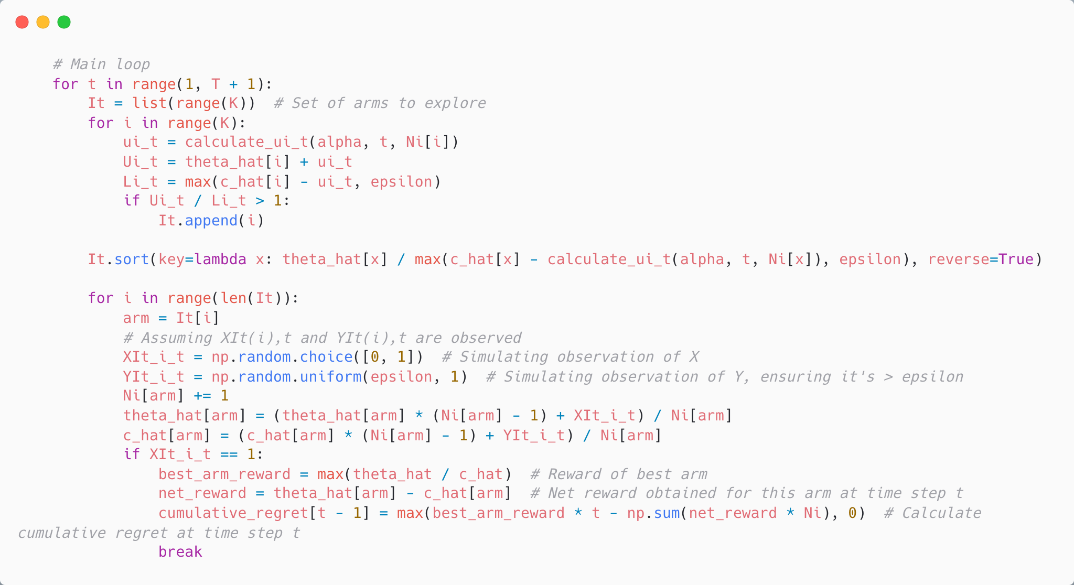
Explanation of python code
We calculate the confidence bounds (UCB and LCB) and compare their ratio with 1 to check the optimality of arms.
We add all the optimal arms for time t to set I_{t} and sort it in the descending order.
Notes:
After the initial exploration phase where we observe the values of arm states and costs, the algorithm proceeds to calculate confidence bounds for each arm. These confidence bounds, represented by the Upper Confidence Bound (UCB) and Lower Confidence Bound (LCB), provide crucial insights into the uncertainty surrounding the estimated values of arm parameters.
The algorithm then compares the ratio of UCB to LCB with 1 to assess the optimality of each arm. If this ratio exceeds 1, it indicates that the arm is potentially optimal and worthy of further exploration or exploitation.
Once the optimal arms for the current time step t have been identified, we add them to a set denoted as It. This set comprises all the arms deemed optimal for time step t. To ensure efficient decision-making, we sort this set in descending order based on the estimated values of arm parameters.
This sorting step is crucial as it enables the algorithm to prioritize exploration or exploitation of arms with higher potential for maximizing rewards. By focusing on arms with the highest estimated values, the algorithm can expedite the process of learning and optimization, leading to more efficient resource allocation and higher cumulative rewards over time.

Slide 8

Explanation of python code
Now, we explore each arm in I_{t} and observe its reward and cost, if the reward is 1, we stop exploring further.
We also keep on updating N_{i,t} $,\hat{\text{θ}}$, $\hat{c}$ for the observed arms, and calculate the cumulative regret.
Notes:
Having identified the optimal arms for the current time step t and sorted them in descending order, the algorithm proceeds to explore each arm in the set It. For each arm exploration, the algorithm observes the associated reward and cost.
If the observed reward for a particular arm is 1, indicating success or a positive outcome, the algorithm stops further exploration. This is due to the cascading nature of our problem, where the user observe the arms sequentially and finally stops at the arm which he likes, leaving the rest of the arms unobserved.
Throughout the exploration process, the algorithm keeps track of various parameters for each arm, including the number of times the arm has been pulled (Ni,t), the estimated expected value (θ_hat), and the estimated cost (c_hat). These parameters are continuously updated based on the observations made during arm exploration.
Additionally, the algorithm calculates the cumulative regret at each time step. Cumulative regret represents the difference between the rewards obtained so far and the maximum possible rewards that could have been obtained if the learner had perfect knowledge of the arm values from the beginning.
These steps form the core of the CC-UCB algorithm's operation, driving its exploration-exploitation trade-off and facilitating efficient learning and optimization in dynamic environments.

Slide 9
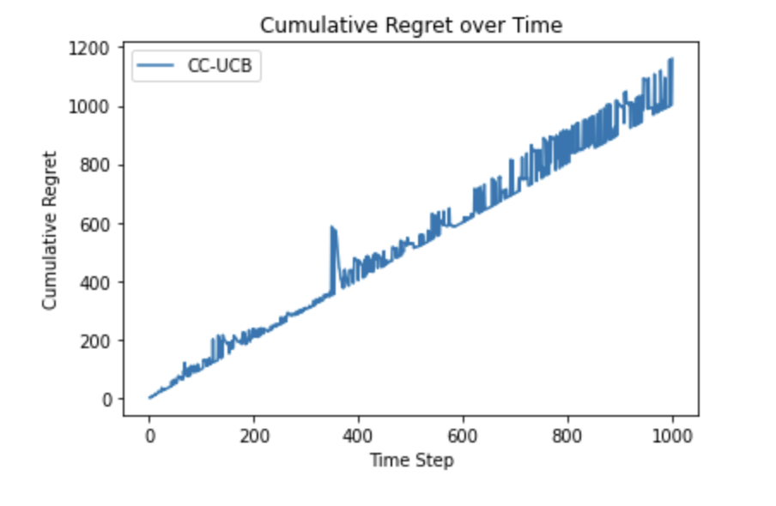
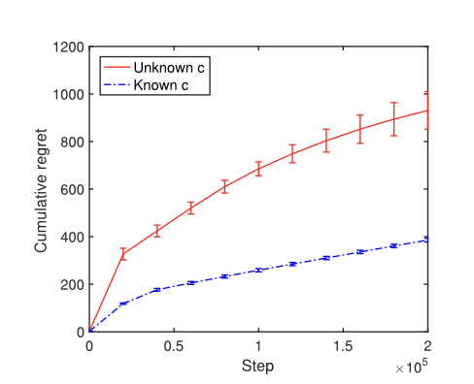
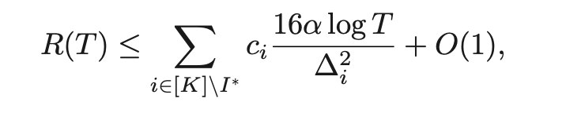
Main results
Finally, we plot the cumulative regret v/s the number of time steps.
The plot deviates from a straight line but is not logarithmic also, ideally the it should be logarithmic, according to the bounds calculated in the paper.
Notes:
After executing the algorithm over multiple time steps, we generate a plot illustrating the cumulative regret versus the number of time steps. This plot serves as a visual representation of the algorithm's performance and provides insights into its effectiveness in learning and optimization.
Upon examining the plot, we observe that the cumulative regret does not follow a straight line. However, it also does not exhibit a logarithmic trend, which ideally it should, according to the bounds calculated in our research paper.
This deviation from the expected logarithmic trend indicates potential areas for further investigation and optimization. It suggests that while the algorithm performs reasonably well, there may still be room for improvement in terms of redefining the formula for regret calculation and choosing right values of the constant parameters.

Slide 10
PROBLEM SETUP of CCB-Setting
Arm Set: Consider a set of K items (arms) denoted as [K] = {1, 2, ..., K}.​
Item States: Each item i ∈ [K] has two states: 0 and 1.States evolve based on an i.i.d. Bernoulli random variable.​
Learning Agent Action: Chooses an ordered list of items in each step. Examines items sequentially until a stopping condition is met.​
Reward Mechanism: Receives a reward of one if any examined item has state 1. Otherwise, the reward is zero.​
Cost Association: Each item examination incurs a random cost.​
Net Reward Function: Calculated as the reward obtained minus the total examination costs incurred before stopping
Notes:
Let us recall the problem setting of cost-aware cascading bandits. Arm Set: We begin with a set of K items, often referred to as arms, denoted as [K] = {1, 2, ..., K}. Each item represents a potential choice or action available to the learning agent.
Item States: Each item i ∈ [K] has two possible states: 0 and 1. These states evolve based on an independent and identically distributed (i.i.d.) Bernoulli random variable. This stochastic nature of item states adds an element of uncertainty to the learning process.
Learning Agent Action: The learning agent selects an ordered list of items in each step. It examines these items sequentially until a stopping condition is met. This sequential exploration strategy allows the agent to gather information about the states of the items while optimizing resource allocation.
Reward Mechanism: The learning agent receives a reward of one if any examined item has state 1, indicating a positive outcome or success. Otherwise, the reward is zero. This reward mechanism incentivizes the agent to identify items with state 1 efficiently while minimizing the number of item examinations.
Cost Association: Each examination of an item incurs a random cost. These costs are associated with the exploration process and add a practical constraint to the learning problem. The agent must balance the desire to maximize rewards with the costs incurred during exploration.

Slide 11
complexity analysis of CC-UCB algorithm
In the cascading bandit algorithm, the agent was trying to classify items into different sets, based on the confidence bounds of their weights w(i) (or click probability).
The more is the difference of weight between item i and K_{th} item (which is denoted by ∆_{i}), it is difficult to identify its set.
The number of times, the algorithm must observe the item’s feedback to correctly identify it with probablity 1 − δ/2 is denoted by T_{i,δ}, which depends mainly on ∆_{i} and δ.
Notes:
Now, we move on the time complexity bound calculations for our CC-UCB algo. From the analysis of time complexity of CascadeBAI algo, discussed earlier, following important observations are made :
In the cascading bandit algorithm, the learning agent faces the challenge of classifying items into different sets based on the confidence bounds of their weights w(i), which represent their click probabilities or expected rewards.
A crucial factor influencing this classification process is the difference in weight between an item i and the Kth item, denoted by ∆i. Intuitively, larger differences in weights make it more challenging to accurately classify an item into its correct set.
To ensure a high probability of correctly identifying an item's set, denoted by 1 − δ/2, the algorithm must observe the item's feedback a certain number of times. This number of observations required, denoted as Ti,δ, depends primarily on the magnitude of ∆i and the chosen confidence level δ.
Understanding the relationship between ∆i, δ, and Ti,δ is crucial for assessing the computational complexity of the CC-UCB algorithm. As ∆i and δ vary across different scenarios, the number of observations required for accurate classification also fluctuates, impacting the overall complexity of the algorithm.

Slide 12
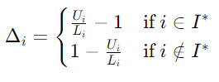
complexity analysis of CC-UCB algorithm
UPPER BOUND
Similar to the CascadeBAI, the CC-UCB algorithm also classifies the arms by comparing the ratio of confidence bounds of reward and cost, where U_{i} is the UCB of reward and L_{i} denotes the LCB of cost. If their ratio is greater than 1, then the arm is pushed into I* (called Active set), else is rejected.
So, similarly, we can define the difficulty in terms of ∆_{i} as :
Notes:
Similar to CascadeBAI, CC-UCB also employs a classification mechanism for arms based on the ratio of confidence bounds of reward and cost. Specifically, if the ratio of the Upper Confidence Bound (UCB) of reward (Ui) to the Lower Confidence Bound (LCB) of cost (Li) is greater than 1, the arm is included in the active set (denoted as I*). Otherwise, it is rejected.
To quantify the difficulty of correctly classifying arms, we define a parameter ∆i. If arm i belongs to the active set (I*), ∆i is calculated as Ui/Li - 1. Otherwise, if arm i does not belong to I*, ∆i is defined as 1 - Ui/Li.
This definition of ∆i captures the relative differences between the UCB of reward and the LCB of cost for each arm. Arms with higher values of ∆i are more challenging to classify accurately, as their reward-to-cost ratio deviates further from the threshold of 1.
By characterizing the difficulty of arm classification in terms of ∆i, we gain insights into the complexity of the decision-making process in the CC-UCB algorithm. Arms with higher values of ∆i require more observations and careful consideration to be correctly classified, impacting the overall performance and efficiency of the algorithm.

Slide 13
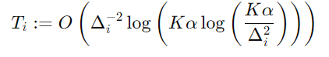
complexity analysis of CC-UCB algorithm
Now, we are interested in knowing how many times a particular arm is observed, before it gets either included or rejected in set I*. The arms should be choosen in such a way that the regret remains bounded. We denote this quantity by T_{i}. From our algorithm, we can bound T_{i} as follows :
where K is the total number of arms and ɑ is the regret parameter.
A larger ∆_{i} leads to a smaller T_{i}, implying that it requires fewer observations to identify item i correctly. The permutation σ defines the ordering of ∆ : ∆_{σ(1)} ≥ . . . ≥ ∆_{σ(K)} .
Notes:
Taking insights from the analysis of cascading bandits in fixed confidence setting, we know that to bound the overall time complexity of our CC-UCB algorithm, it would be helpful if we can bound the number of times each arm is observed (let us say it is Ti).
Now, upon carefully analysing the pseudo code and proofs given in research paper, we derive that this Ti is mainly dependent on two factors - delta(i) and alpha.
We have already discussed the dependence on delta(i), and since our CC-UCB algorithm is based on regret minimization (or we can say, fixed budget setting) it depends on alpha. After comparing and analysing the confidence bound and reget minimization, we arrive at the following bound:
We can see that a larger ∆i leads to a smaller Ti, implying that it requires fewer observations to correctly identify arm i. This observation aligns with intuition, as arms with more significant differences in reward-to-cost ratio are easier to classify accurately.

Slide 14
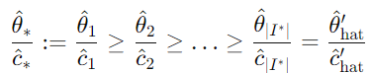
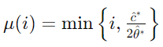
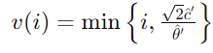


complexity analysis of CC-UCB algorithm
Here, ${\hat{θ}}_{i}$ and ${\hat{C}}_{i}$ denote the sample average of θi and ci after all the steps, respectively.
The lower bound on can be defined as
and the upper bound on $E\left[N_{i,t}\right]$ can be given as
$$E\left[N_{i,t}\right]$$
Notes:
Now, moving parallel to the derivation carried out for general cascading bandits.
We define the maximum ratio of theta_hat by c_hat over all arms as theta_hat_star and c_hat_star, and minimum ratio of theta_hat by c_hat as theta_hat_dash and c_hat_dash.
Now, we are able to bound the expected number of times arm i is pulled till any time instant t. The lower bound can be written as: and the upper bound as:
These functions are one the major contributions put forward by us.
We will further see how these values help us in calculating the final upper bound.

Slide 15
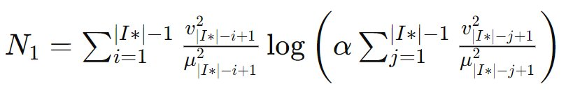


complexity analysis of CC-UCB algorithm
The first term N1 in the bound is unique to the cascading model, which results from the gap between and E $N_{i,t}$. We got similar Value of N1 for CCB as we got in simple cascading bandit , the expression is given as :
$$N_{i,t}$$
Notes:
Now, we will derive all the three major bounding terms using the parameters that I have just discussed.
The term N1 occurs in all the cascading bandit algorithms and is dependent on lower + upper bound of Ni,t, alpha and no of elements in active set.

Slide 16
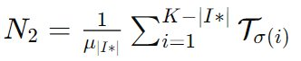
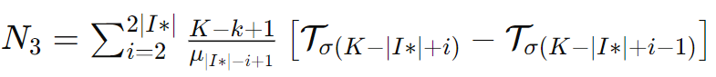

complexity analysis of CC-UCB algorithm
With probability at least 1 – 1/$a$ , it costs at most c2N2 steps to identify items $σ$(1), . . . $σ$ (K -|I*| ) and c3N3 is for identifying the remaining ones. More precisely, after item $σ$(K-|I*|- I - 1) is identified, the number of steps required for identifying item (K-|I*| - i) is given below :
For overall complexity , we will take all the three terms i.e N1,N2,N3, So , to get best arms in CCB we need at most C1N1 + C2N2 + C3N3 steps.
Notes:
The second term N2 occurs due to the time steps used in exploring all the arms that are not included in I*. This term depends on the lower bound of their Ni,t and Ti (which is intutive, as it bounds the number of minimum observations so that we incur minimum regret). The third and the last term N3 is for the remaining terms, that is, those belonging to the active set. Hence, it is a similar function as N2.
The total upper bound is a linear combination of the 3 bounds.

Slide 17
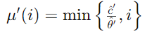
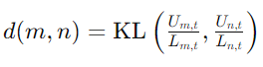
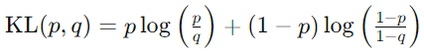

LOWER BOUND
We have calculated the upper bound of expected number of observation of items per step as calculated in simple Cascade bandit setting . For our bandit , we have term of $\hat{θ}$ and $\hat{c}$ instead of w. The upper bound is given by:
Similarly, We have defined d (m,n) as KL divergence of the ratio U/L of two arms say m, n:
where,
Notes:
Once we have calculated the upper bound, the analysis of lower bound becomes easy.
Here, we have used the upper bound on Ni,t (that is the number of times arm i is observed till time step t). The expression is similar as used for deriving the upper bound. We have used the similar idea of replacing weights with the ratio of UCB of reward and LCB of cost, which gives us the following value of d(m,n).

Slide 18
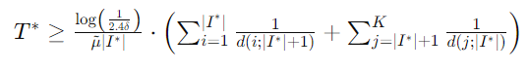
Lower bound
So, we got the lower bound of the time complexities as written below, it is similar to cascading setting.
Notes:
And, finally we calculate the lower bound which depends on alpha, number of elements in active set I* and the lower bound and d(m,n) defined previously.
This result is similar as obtained for the CascadeBAI algorithm, but the key difference is that it incorporates the cost of pulling each arm and tries to achieve minimum regret for a given setting.

Slide 19
THANK YOU !
Notes:
Now, we come to the end of our presentation. Thank you so much for your time and attention.

